Slide 1
BRIGHTTV
VIEWERSHIP ANALYTICS
South African TV Consumption — User & Viewership Trends Report
9
12+
2016
Provinces
Channels
Data Year
Prepared for BrightTV Leadership · April 2026 By Thandeka Ngetu

Slide 2
AGENDA
01
User & Usage Trends
Demographics, provinces, channels and viewing behaviour
02
Factors Influencing Consumption
Time of day, day of week, gender, race and duration patterns
03
Content Recommendations
Strategies to boost viewership on low-consumption days
04
Growth Initiatives
Actionable recommendations to grow BrightTV's user base

Slide 3
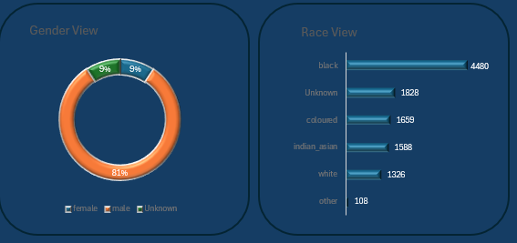
01 | USER DEMOGRAPHICS
81.% of viewers are male. Black viewers represent the largest racial group (41.%). The gender gap presents a significant growth opportunity for female targeted content.

Slide 4
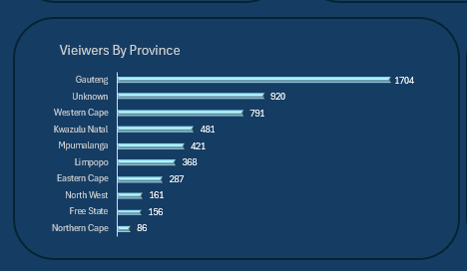
01 | GEOGRAPHIC DISTRIBUTION
34.1%
Gauteng Share
17.0%
Western Cape
9.4%
KZN
Urban provinces dominate viewership. Rural outreach could significantly expand the addressable market.
58.5%
Top 3 Provinces

Slide 5
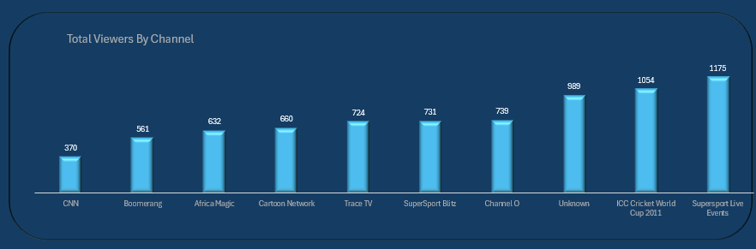
01 | TOP CHANNELS
Sports content (SuperSport + ICC Cricket) accounts for 28% of total viewership which is the dominant content category.

Slide 6
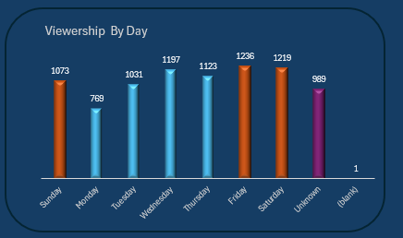
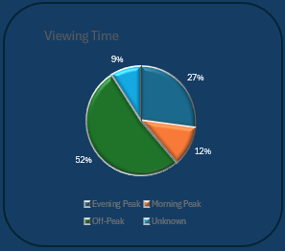
02 | VIEWING TIME PATTERNS
📅
🌙
📺
☀️
Friday is the peak day (1,675 sessions)
52% of viewing occurs Off-Peak
27.% Evening Peak (18:00–22:00)
Weekend share: 27.% of all views

Slide 7
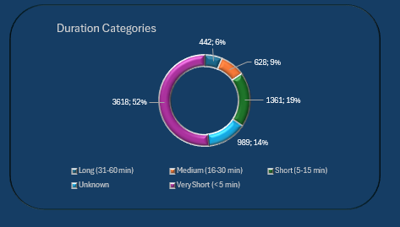
02 | SESSION DURATION ANALYSIS
52%
Very Short
Under 5 minutes
19%
Short
5–15 minutes
Medium
9%
16–30 minutes
6%
Long
31–60 minutes
52% of sessions are under 5 minutes indicating channel surfing or short content clips are the dominant viewing behaviour.

Slide 8
02 | FACTORS INFLUENCING CONSUMPTION
🧑 Gender
🕐 Time of Day
Male viewers dominate at 81.5%. Female viewers under-represented. Content mix may not cater to female preferences.
Evening Peak (18–22h) drives 27.1% of sessions. Off-peak hours (61.2%) show opportunity for always-on content.
📍 Geography
📅 Day of Week
Urban areas (Gauteng, Western Cape, KZN) drive 58.5% of traffic. Rural provinces remain underpenetrated.
Friday–Sunday = highest viewership. Monday is the lowest. Midweek engagement is inconsistent and needs stimulation.
⚽ Content Type
⏱ Duration
Sports content leads with ~28% share. Music channels (Channel O, Trace) show strong youth engagement.
63.5% of sessions under 5 min. Engaging long-form content could significantly increase total watch time.

Slide 9
03 | CONTENT RECOMMENDATIONS
📉 LOWEST CONSUMPTION DAYS: Monday (957 sessions) & Tuesday (1,322 sessions)
01 Monday Night Sports Replays
02 Tuesday 'New Release' Premieres
03 Interactive Viewer Challenges
Air weekend sports highlights and replays on Monday evenings to recapture sports fans who missed live events.
Schedule new episodes and movie premieres on Tuesdays to create a weekly appointment-viewing habit.
Gamify Monday/Tuesday viewing with live polls, quizzes, and social media integration to drive engagement.
04 Kids & Family Content (Morning)
05 Local Language Programming
06 Binge Bundles & Catch-Up Series
Target morning off-peak hours with children's educational content — Cartoon Network already shows demand.
Introduce Zulu, Xhosa, and Sotho programming to tap under-served communities in KZN, Eastern Cape, and Limpopo.
Promote weekend series catch-up on Mondays to convert weekend viewers into weekday users.

Slide 10
04 | GROWTH INITIATIVES
01 Female Audience Strategy
02 Rural & Province Expansion
▸ Commission female-led reality, lifestyle & drama content
▸ Targeted mobile data bundle partnerships for rural provinces
▸ Partner with women's brands for sponsored programming
▸ Offline download feature for low-connectivity areas
▸ Create a 'BrightTV Women' curated channel block
▸ Local language content for Limpopo, Eastern Cape & North West
03 Youth & Digital Engagement
04 Retention & Loyalty Programme
▸ Short-form vertical content for mobile-first Gen Z viewers
▸ Personalised content recommendations based on viewing history
▸ TikTok/Instagram integrations to drive app discovery
▸ Loyalty rewards for consistent daily viewing streaks
▸ Youth sports leagues and esports streaming
▸ Exclusive content for long-session (30min+) subscribers

Slide 11
KEY TAKEAWAYS
BrightTV at a Glance
📺 Sports & Music are the backbone — protect and expand these categories
👩 Female audience is a major untapped growth opportunity at only 9.3%
📍 3 provinces deliver 58.5% of views — rural expansion is key to scale
⏰ Mondays & Tuesdays need targeted content to lift the weekly floor
📱 52% of sessions are <5 min — invest in engaging longer form content
🚀 Loyalty, personalisation & local language content drive retention
BrightTV · Viewership Analytics · 2026 · Confidential

